Slide 1
Exoplanets
Abigail O’Neill – Group 2

Slide 2
Week 1
Looked through resources on canvas and took notes to get a basic understanding of the content.
  https://agupubs.onlinelibrary.wiley.com/doi/full/10.1029/2020JE006639
Downloaded the table from the exoplanet archive for everyone to use.
Read through the sample selection paper to keep up to date with how we aim to select the exoplanets.
  https://iopscience.iop.org/article/10.3847/1538-3881/ac9f45/pdf

Slide 3
Week 2
Read through the MCMC guides to get basic understanding of the statistics.
  https://prappleizer.github.io/Tutorials/MCMC/MCMC_Tutorial_Solution.html
  https://emcee.readthedocs.io/en/stable/
Practised using MCMC on simulated data from chat GPT for a quadratic model.
  Initially, I attempted to apply MCMC on light curve data from my year 2 lab, but it was very complex so I switched to model simulated data to focus on understanding the statistics.

Slide 4
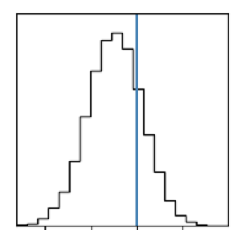
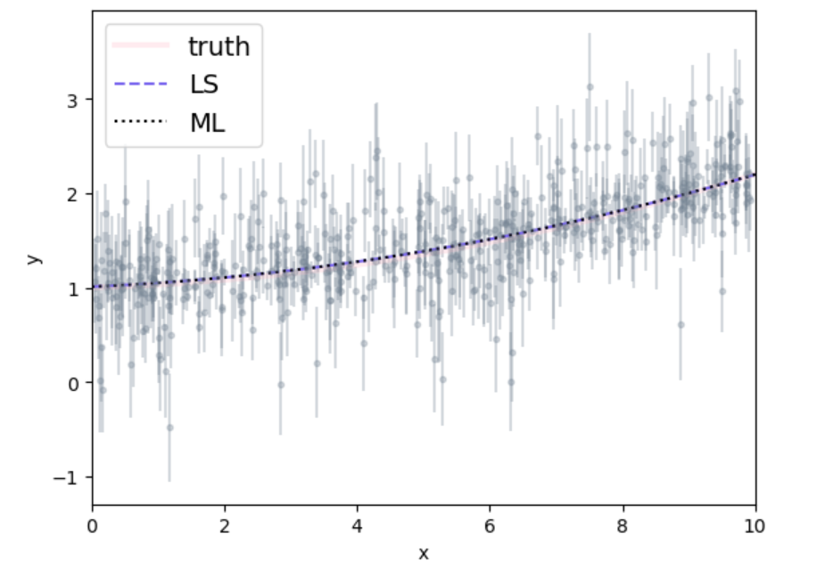
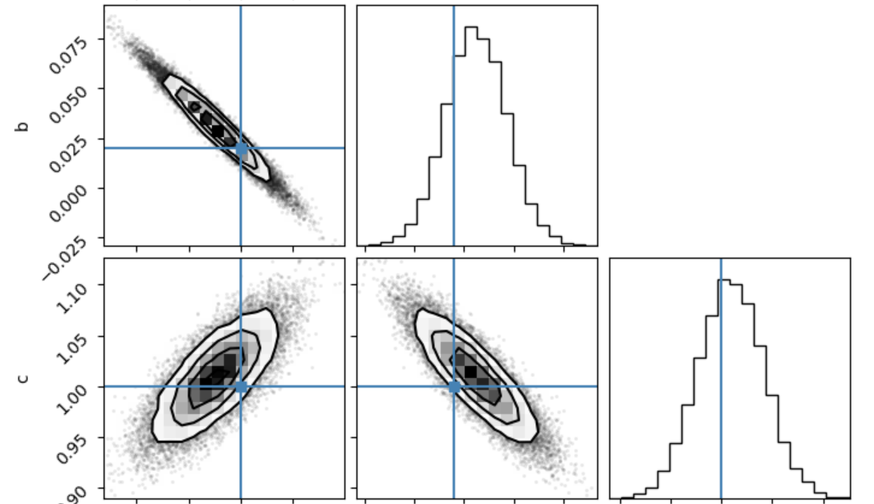
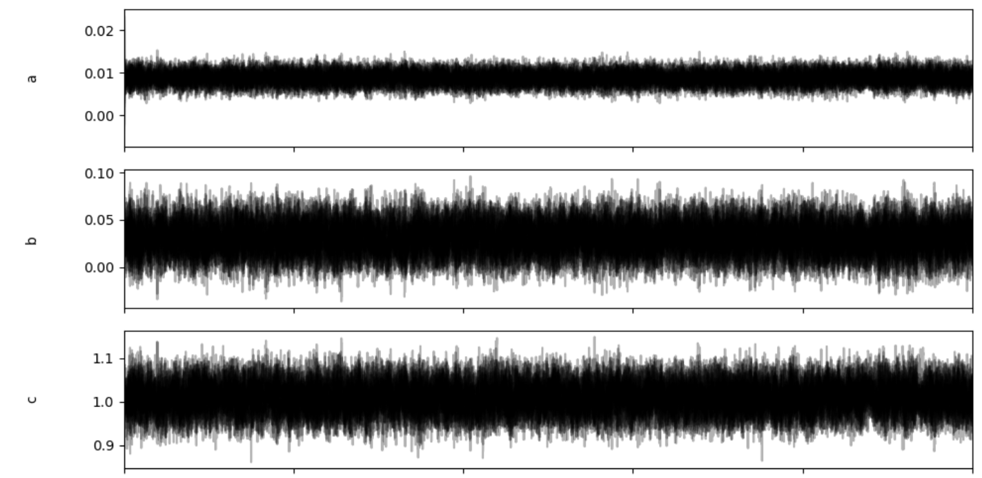
Graph of simulated data:
- Gray points are simulated data points
- Pink is the true model
- Blue is the least square estimate
- Black is the maximum likelihood
Least Squares (LS) and Maximum Likelihood (ML) fits closely recover the true trend despite significant observational noise.
These plots show how each MCMC walker moves through parameter space as the number of steps increases. The walkers quickly settle into a horizontal band and then randomly wiggle, indicating the sampler has found the posterior distribution. The strong overlap between walkers shows good mixing and that the MCMC has converged.
Larger amplitude means the MCMC is exploring a wider range and therefore more uncertainty in that parameter.
Diagonal (1D histograms):
Peak at most probable value of parameter
Spread/ width is the uncertainty
Shape:
Gaussian: approx normal uncertainty
Skewed: asymmertric uncertainty
Off-diagonal (2D):
- tilt: indicated correlation
- circular contours: Low/no correlation
elongated: high correlation

